Slide 1
Five Cool Things to Know and Use for Smart Client Development with Microsoft Visual Studio 2008 and the Microsoft .NET Framework 3.5
Rudi Grobler
http://dotnet.org.za/rudi
Notes:
Hello and welcome to this session. My name is {insert your name}.
Have a look at this title slide… What do you see?
Definitely the longest title at {conference name}
Lets try to tidy up this title a little…

Slide 2
5 Cool Things to Know and Use for Smart Client Development with VS2008 and Fx 3.5
Rudi Grobler
http://dotnet.org.za/rudi
Notes:
Lets remove a little of the branding and see what we have left?
Only 3 lines… lets start from the bottom up
VS2008 + Fx 3.5 – Everything covered today is available out of the box in VS2008 and .NET 3.5
Smart Client Development – Client (Desktop) development (No web)
5 Cool things – 5 demos (Hopefully cool and useful)
All the other sessions only show you 1 thing… I will try and show you 5!!! Just remember that when you are filling in the evaluation forms…
So, what are these 5 things?

Slide 3
AGENDA
Demos
WinForms and WPF Interop
Managed Extensibility Framework
Client Application Services
ADO.NET Sync Services
VSTO v3.0 (Customising Office)
Notes:
All of you here have probably seen at least on of these demos... But hopefully none of you know all 5!
The purpose of this talk is not to explain in depth all the new technologies but to rather just highlight some of the cool new things...
Lets start with the first demo...

Slide 4
“In an ideal world, once developers master a new technology such as WPF they’d leave the previous framework behind. Everything would be written using the latest, most capable toolkit, and no one would ever worry about legacy code.” – Matthew MacDonald
Notes:
Scenario: Starting with WPF but you have huge investments in WinForms (Expensive 3rd party controls, etc)

Slide 5
Why interop?
WPF using WinForms?
Leverage existing code investments
Compensate for missing features in WPF
WinForms using WPF?
Add some WPF “shine”
Some control not available (ie. FlowDocument)
Notes:
Starting with WPF doesn’t mean you should throw away investments made into previous technologies like WinForms… Its extremely easy to interop between the 2 technologies!
Why would WPF need or want to use WinForms. It’s a old technology? You might have existing code you want to leverage. WPF also doesn’t yet have all the controls available in WinForms
Why would WinForm need or want to use WPF. You might want to add a little bit of WPF shine to your application or the more compeling reason: Controls in WPF which isn’t available in WinForms (Like the FlowDocument)

Slide 6
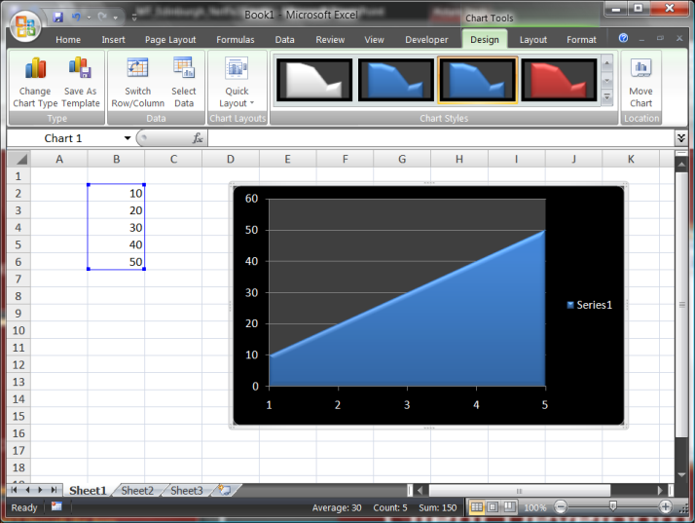
WinForms hosting WPF
demo

Slide 7
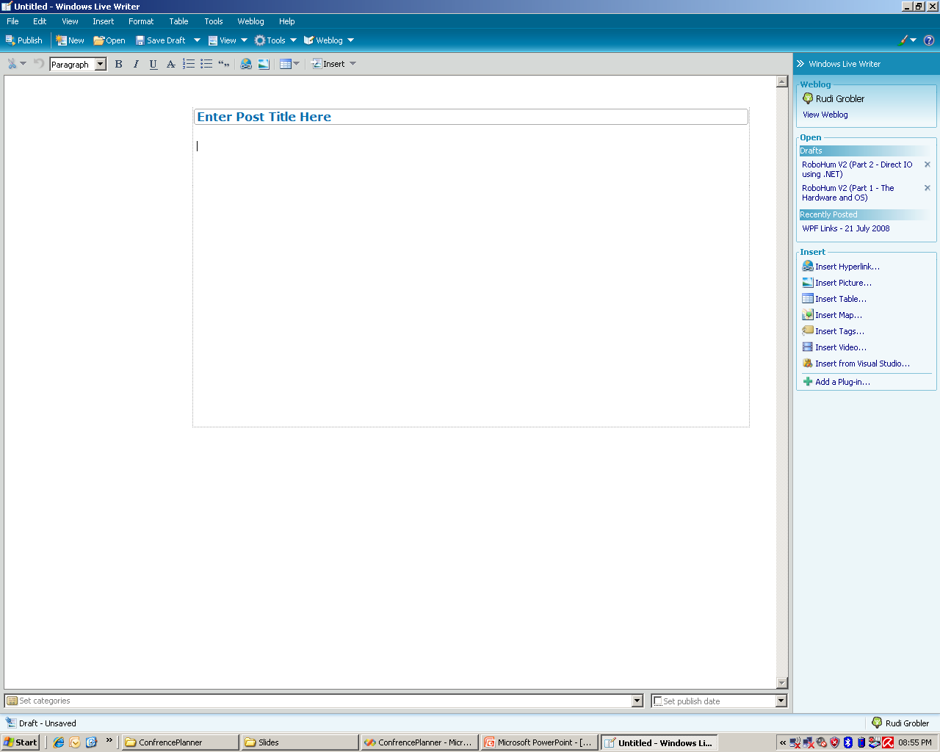

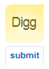
Why create a extendable application?

Slide 8
MEF Makes Extensibility
Fun
Feasible
Fabulous
Fly
Frupendous
Fast
Flavorful
Notes:
Disclaimer: MEF do not ship in VS2008 out of the box but will be in .NET 4.0. MEF is also used in VS2010
Name ANY popular application? VS, Photoshop, WOW, Live Writer, etc… What do thy have in common? Extensibility!!!

Slide 9
Managed Extensibility Framework
demo

Slide 10

Client Application Services
Leverage existing infrastructure
Authentication, Roles & Profiles
Authentication
Web
Role Management
Laptop
.NET Client
Profiles
Application Services
Server
Notes:
Scenario: Existing website needs a smart client to access the data. You do not want to recreate all the logins, profiles and roles but rather re-use the website application service
Application Services was introduced in ASP.NET 2. Application Services was designed to be easily used by websites. In .NET 3.5, these services are also now exposed to desktop applications in a very transparent way.

Slide 11
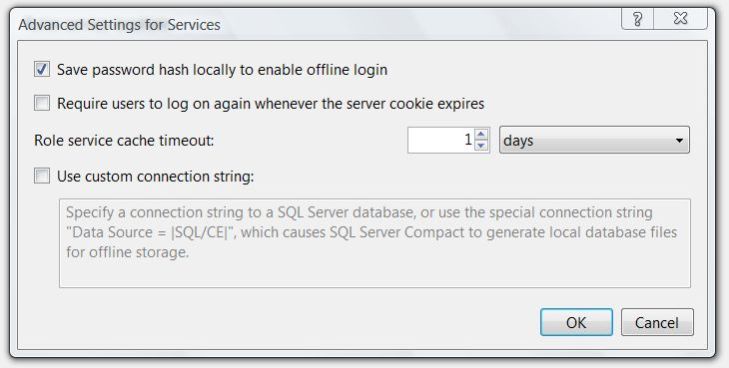
Client App Services
demo

Slide 12
Tenent of a Smart Client
Offline Capable
Because they are running on the local machine one of the key benefits that smart client applications offer is that they can be made to work even when the user is not connected. For applications running in occasional or intermittent connectivity situations, such as those used by traveling workers or even those running on laptops, tablets, PDA's, and so on, where connectivity cannot be guaranteed at all times, being able to work while disconnected is essential. Even when the client is connected, the smart client application can improve performance and usability by caching data and managing the connection in an intelligent way.

Slide 13






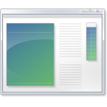



ADO.NET Data Access
Request made of the server
DataAdapter.SelectCommand executed returning a result via DataSet
Changes made in-memory, to the DataSet and sent back
DataAdapter shreds changes to Insert, Update and Delete commands
DataAdapter
SelectCommand
Server
DB
InsertCommand
Connection
Forms
UpdateCommand
DeleteCommand
Communicate over services
All operations round trip to the server
Minimal leverage of the client – memory based operations
Fragile to network instability
Notes:
How do we do data access today?
Query for some data via DataAdapter (Select command)
You get some data back
Use and/or change data
Send it back to the database
You are always hitting the server? What if there is no connection to the server
Now it’s a dumb terminal and not a smart client

Slide 14
Sync Services for ADO.NET
Builds on DataAdapter
Adds Incremental Commands
Adds Conflict Commands
Accepts and returns DataSets
Select Incremental Inserts
Select Incremental Updates
DataAdapter
SyncAdapter
Select Incremental Deletes
SelectCommand
Server
DB
InsertCommand
Connection
Forms
UpdateCommand
DeleteCommand
Select Conflict Updated Rows…
Select Conflict Deleted Rows…
Notes:
Build on top of the familiar DataAdapter model
DataAdapter -> SyncAdapter
Adds Incremental select, update & delete
Use local copy of SQL Compact (Who has used this?) Tip of the session – look at SQL CE (In memory db, click once deployable and no need for a service)!!!
Local CPU & RAM!!!

Slide 15
Sync Services for ADO.NET
Local storage to capture background sync operations
Sync moves data between the local store and the remote service
Application still works with data, but the data is now local
App is now resilient to network instability
Select Incremental Inserts
Select Incremental Updates
SyncAdapter
Select Incremental Deletes
Server
DB
InsertCommand
Connection
Forms
UpdateCommand
DeleteCommand
Select Conflict Updated Rows…
Select Conflict Deleted Rows…
SQL Server Compact 3.5

Slide 16
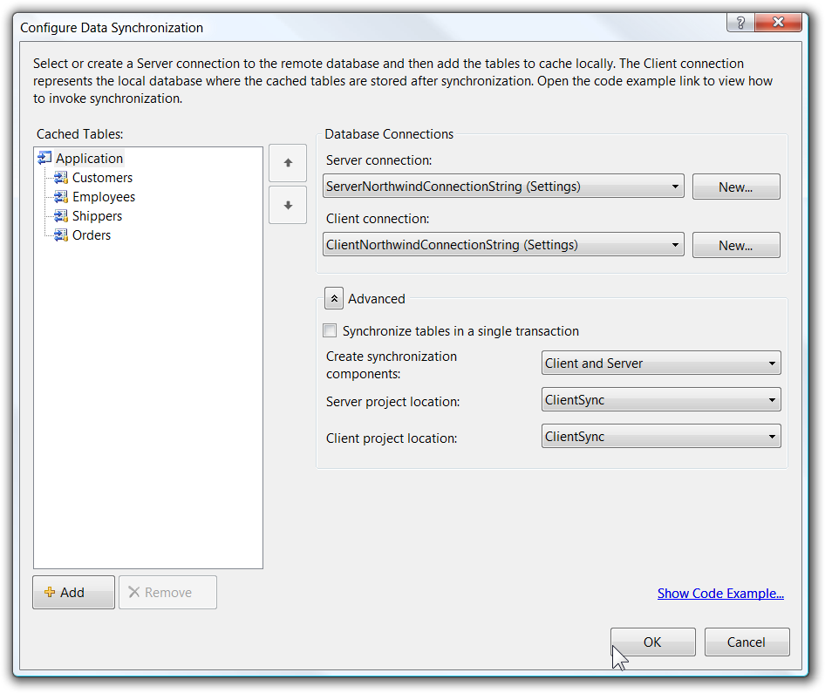
ADO.NET Sync Services
demo

Slide 17
Tenent of a Smart Client
Utilizes Local Resources
A smart client application always has code artifacts on the client that enable local resources to be utilized. What do we mean by local resources? We mean everything from hardware to software resources. A smart client may take advantage of the local CPU or GPU, local memory or disk, or any local devices connected to the client, such as a telephone, bar-code/RFID reader, and so on. But it may also take advantage of local software, such as Microsoft Office applications, or any installed line-of-business (LOB) applications that interact with it.

Slide 18
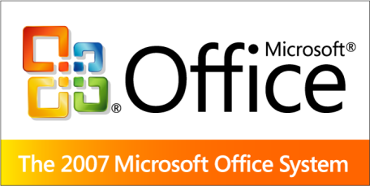
Visual Studio Tools for Office v3.0
2003 & 2007 Support
2007 Customisations
Document Level
Application Level
Office Ribbon Designer
Outlook Form Region Designer
Action & Custom Task Panes
Word Content Controls
ClickOnce Deployment and improved Security
Notes:
Installed on MILLIONS of PCs
No context switch between office and your application!!!

Slide 19
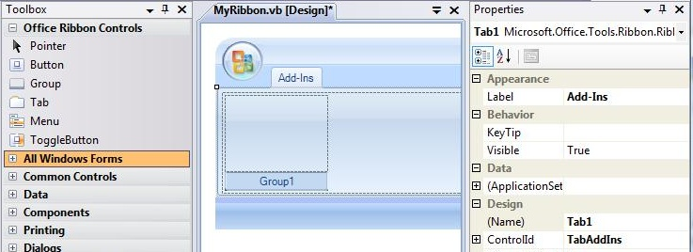
VSTO Customisations
demo

Slide 20
REVIEW
ADO.NET Sync Services v1.0
WinForms and WPF Interop
Client Application Services
Managed Extensibility Framework
VSTO v3.0 (Customising Office)

Slide 21

Summary
Interop Rather than Re-write
Build an Ecosystem Around your App
Embrace S+S
Integrate with Office
Notes:
Do not throw away but interop
Build a echo system around their applications
Embrace Software + Services
Intergrate with Office

Slide 22

© 2007 Microsoft Corporation. All rights reserved. Microsoft, Windows, Windows Vista and other product names are or may be registered trademarks and/or trademarks in the U.S. and/or other countries.
The information herein is for informational purposes only and represents the current view of Microsoft Corporation as of the date of this presentation. Because Microsoft must respond to changing market conditions, it should not be interpreted to be a commitment on the part of Microsoft, and Microsoft cannot guarantee the accuracy of any information provided after the date of this presentation. MICROSOFT MAKES NO WARRANTIES, EXPRESS, IMPLIED OR STATUTORY, AS TO THE INFORMATION IN THIS PRESENTATION.

